Slide 1
Installation Guide
(Eclipse Plug-in － Q4E on Eclipse 3.4)
2009. 02. 25
CODELABOR
Shin Sang Jae (codelabor@gmail.com)

Slide 2
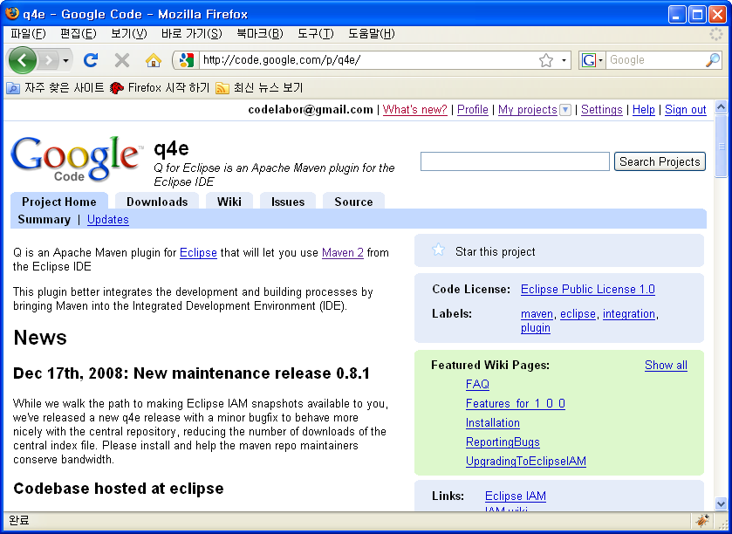
Eclipse Plug-in
Update
Q for Eclipse is Apache Maven plugin for the Eclipse IDE
Officical Site: http://code.google.com/p/q4e/

Slide 3
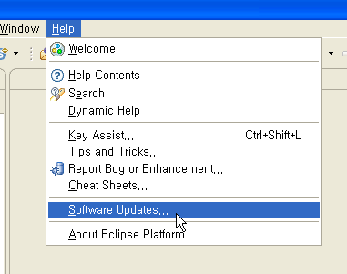
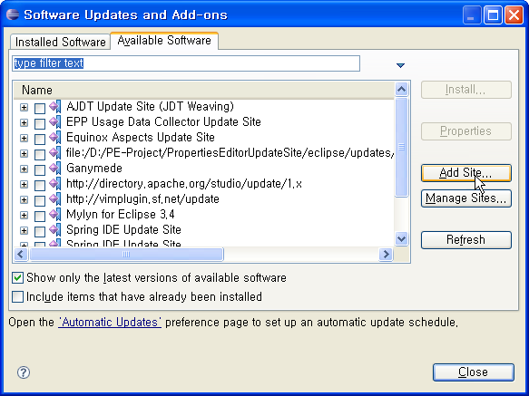
Eclipse Plug-in
Update
Eclipse > Help > Software Updates... > Available Software
Click Add Site

Slide 4
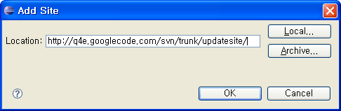
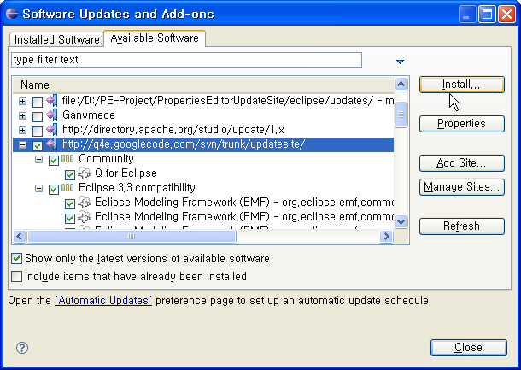
Eclipse Plug-in
Update
Add Site
Update Site: http://code.google.com/p/q4e/wiki/Installation
Check q4e
Click Install

Slide 5
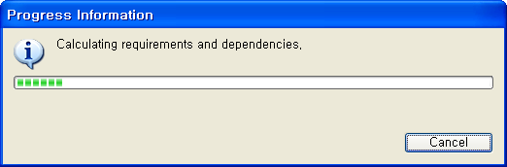
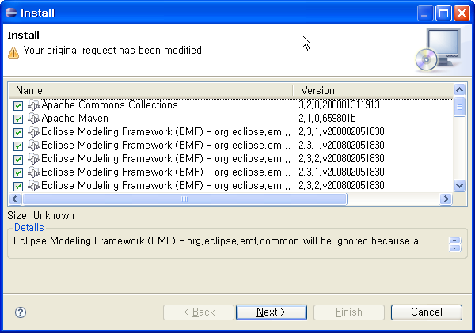
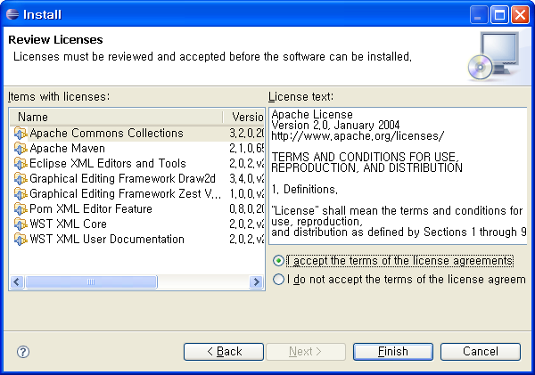
Eclipse Plug-in
Update

Slide 6
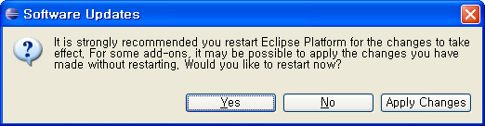
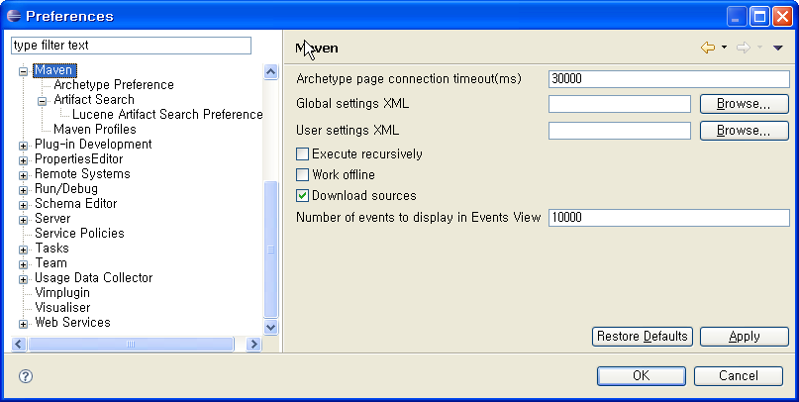
Eclipse Plug-in
Update
Restart eclipse
Check Preference

